Slide 1
Since 1992, CTI has been the leading executive search firm for the banking industry throughout the United States. We are pleased to partner with Awesome Bank.

Slide 2
Awesome Banks Data Points
Awesome Bancorp is Awesome Bank’s holding company, dates back to 1905 when 1st National Bank of Bloomfield opened for business. As regional banks proliferated across the country in the years that followed, a number of other predecessors were born. After a series of mergers at the turn of the 21st century, we formally took on the Bancorp name and established our headquarters in Indianapolis. Today, Awesome Bancorp is the fourth-largest bank in the country, with more than 50,000 employees and $400 billion in assets as of December 31, 2019.
Awesome Bank was acquired by Awesome Bancorp in July 2019. Awesome Banks ranked 9th in the state for banks and savings associations by Metro-area deposits, according to FDIC data and DBJ research as of Nov 30, 2019.
Awesome Bank provides banking, mortgage, private client, investment, treasury management, card services, insurance and consumer finance services to individuals and businesses.
Awesome Bank currently has 25 banking locations, 1,500 employees and $3.5 Billion in assets serving throughout Colorado and the front range.
Learn more at www.ctisearch.com or contact Tim Pendergast – Founder & CEO of Corporate Talent Inc. at 303-792-2989 or timp@ctisearch.com.

Slide 3
Colorado Locations
Arvada Banking Center
5555 West 55th Avenue
Arvada, CO 80002
Boulder Banking Center
5555 Valley Boulevard
Boulder, CO 80302
Breckenridge Banking Center
5555 Washington Avenue
Breckenridge, CO 80424
Broomfield Banking Center
5555 East Crestmark Road
Broomfield, CO 80027
Centennial Banking Center
5555 East Belleview Road
Centennial, CO 80112
Cherry Creek Banking Center
5555 Blake Street, #555
Denver, CO 80206
Colfax Banking Center
5555 E. Parker Avenue
Aurora, CO 80010
Conifer Banking Center
5555 Pleasantville Road
Conifer, CO 80433
DTC Banking Center
5555 S. Boston Street, #555
Denver, CO 80237
Downtown Banking Center
5555 Downing Street, #555
Denver, CO 80202
Edwards Banking Center
5555 New Castle Boulevard, Suite D555,
Edwards, CO 81632
Erie Banking Center
5555 South Prairie Street
Erie, CO 80516
Evergreen Banking Center
5555 Garden Parkway
Evergreen, CO 80439
Golden Banking Center
5555 Tulip Road
Golden, CO 80401
Hampden Banking Center
5555 E. London Avenue
Denver, CO 80224
Idaho Springs Banking Center
5555 Carson Street
Idaho Springs, CO 80452
Lakewood Banking Center
5555 S. Olympia Boulevard
Lakewood, CO 80227
Larkridge Banking Center
5555 Brayden Street
Thornton, CO 80023
Mississippi Banking Center
5555 E. Paradise Avenue
Aurora, CO 80012
Nederland Banking Center
5555 South Grant Boulevard
Nederland, CO 80466
Peoria Banking Center
5555 E. 55th Avenue
Denver, CO 80239
Santa Fe Banking Center
5555 S. Ranch Drive
Denver, CO 80223
Winter Park/Fraser Banking Center
5555 US Highway 55
Fraser, CO 80442

Slide 4
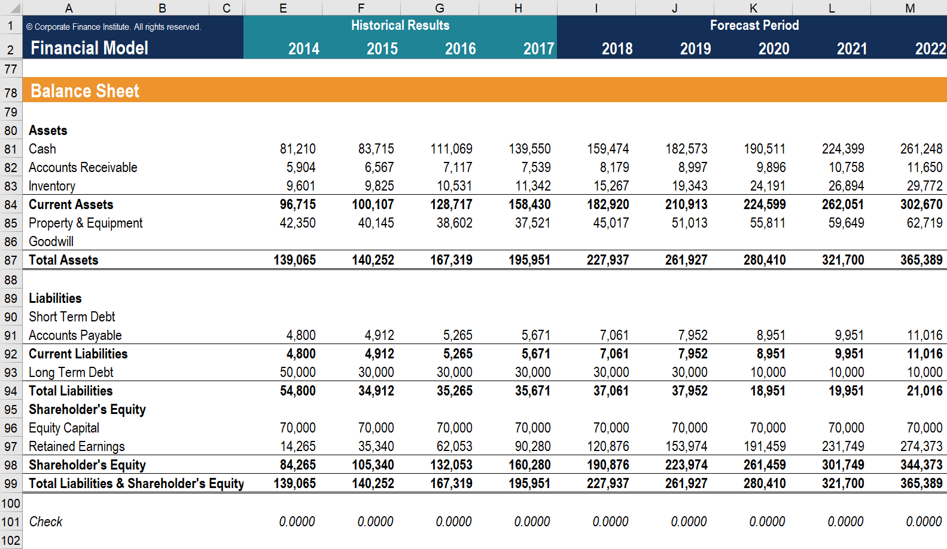
Financials

Slide 5
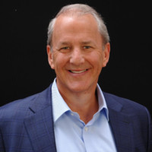
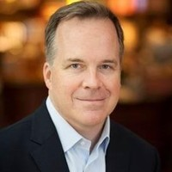
Leadership
Craig Hall
President & CEO – Holding Company
Click Here to view LinkedIn
Craig joined the Holding Company in 2010, and brings more than 25 years of experience in the banking industry. Prior to joining the Holding Company, Craig spent 9 years at a Large Regional Bank, where he held numerous leadership positions with progressive responsibilities. As President and CEO of the Holding Company, Craig oversees the 18 Banks and the holding company which provides support to 130 banking centers, serving 102 communities. Craig earned his Bachelor of Arts degree in business administration and management from the University of Texas.
Joshua Newman
EVP, Regional President – Holding Company
Click Here to view LinkedIn
Joshua, Regional President and EVP has leadership responsibility for the mid-west markets, Holding Company. Joshua joined Awesome Banks as President and CEO in 2006 and has over 30 years of experience in the banking and finance industry. He joined Awesome Banks from a Regional Bank where he served as President and Chief Operating Officer. He was responsible for the initial transition by the Regional Bank to the Chicago market. Joshua graduated from the NYU with a degree in business administration/general business. He also earned his graduate degree in banking from the University of Michigan and attended graduate school of banking at the University of Michigan.

Slide 6
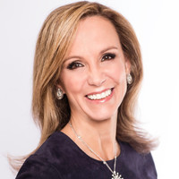
Leadership
Karen Walker
President and CEO - Awesome Banks
Click Here to View LinkedIn
Karen Walker, who was promoted to president & CEO of Awesome Banks in July 2009, was unanimously elected on January 1, 2017, as Chair of the Illinois Bankers Association (IBA).
Walker is the first woman to lead IBA in 20 years and the second ever in the organization’s long history. She will serve a one-year leadership term. The IBA represents more than 95-percent of the 218 banks in Illinois, which account for $154 billion in assets, 1,578 branches and 22,615 banking professionals. The organization focuses on creating a stronger economy and helping Illinoisans realize dreams by building better banks.
Walker’s community involvement extends beyond her Awesome Bank leadership. She is also currently active with Chicago Hospice and Chicago Hopes for Kids.

Slide 7
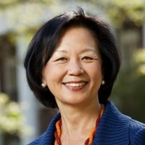
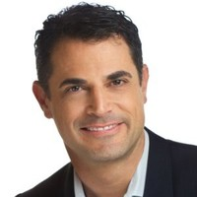
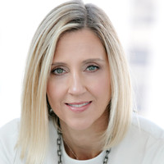
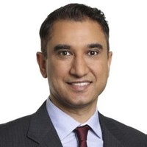
Leadership
Meghan Gram
Market President, North Metro- Awesome Banks
Click Here to View LinkedIn
Berry James
Market President, West Metro - Awesome Banks
Click Here to view LinkedIn
Leslie Parker
Market President, South Metro - Awesome Banks
Click Here to view LinkedIn
Wesley Benson
Market President, East Metro - Awesome Banks
Click Here to view LinkedIn

Slide 8
News Releases Acquisitions
BB&T and SunTrust receive regulatory approvals for merger of equals to form Truist– November 19, 2019
Clients will continue to be served through current brands until system conversionWINSTON-SALEM, N.C. and ATLANTA, Nov. 19, 2019 /PRNewswire/ -- BB&T Corporation (NYSE: BBT) and SunTrust Banks, Inc. (NYSE: STI) today announced receipt of regulatory approvals from the Board of Governors of the Federal Reserve System and the Federal Deposit Insurance Corporation to complete the previously announced merger of equals and become Truist Financial Corporation. Upon completion of the merger, Truist will be the sixth largest U.S. commercial bank, serving approximately 10 million U.S. consumer households and a full range of business clients, with leading market share in many of the most attractive, high-growth markets in the country.
BB&T and SunTrust expect to complete the merger on December 6, 2019, pending satisfaction of customary closing conditions. BB&T common shares will become Truist common shares and SunTrust common shareholders will receive 1.295 Truist common shares for each share of SunTrust common stock they own at the closing. Following the closing, Truist common shares will trade on the NYSE under the symbol "TFC" and depositary shares or preferred purchase securities representing interests in Truist Series F, G, H, I and J preferred shares will trade on the NYSE under the symbols "TFC.PrF," "TFC.PrG," "TFC.PrH," "TFC.PrI" and "TFC.PrJ," respectively.
The regulatory approval process also included approvals from The Georgia Department of Banking and Finance and the North Carolina Commissioner of Banks. The U.S. Department of Justice completed its antitrust review earlier in November as part of an agreement to divest branches in North Carolina, Virginia and Georgia. No further regulatory approvals are required to complete the merger of BB&T and SunTrust and all related subsidiaries.
"We are pleased to have received regulatory approval to merge two strong companies with complementary business models and a high level of cultural alignment. We'll be even better together for our clients, teammates, communities and shareholders," said BB&T Chairman and CEO Kelly King, who will serve as chairman and CEO of Truist.
"We will build upon our mission- and purpose-driven cultures and work to ensure a positive experience for our clients," said SunTrust Chairman and CEO Bill Rogers, who will be president and chief operating officer of Truist prior to succeeding King as CEO in September 2021. Click HERE to read more.

Slide 9
News Releases
Experience Doesn’t Predict a New Hire’s Success
by Alison Beard – September/October 2019 Issue
Chad H. Van Iddekinge of Florida State University and his colleagues reviewed 81 studies to investigate the link between an employee’s prior work experience and his or her performance in a new organization. They found no significant correlation between the two. Even when people had completed tasks, held roles, or worked in functions or industries relevant to their current ones, it did not translate into better performance. The conclusion: Experience doesn’t predict a new hire’s success.
Professor Van Iddekinge, defend your research.
Van Iddekinge: We were surprised. It seems so intuitive that applicants who have general work experience or have already done the job that they’re applying for would be at an advantage. But when we looked at all these studies—and we sifted through thousands to find the 81 with pertinent data—we discovered a very weak relationship between prehire experience and performance, both in training and on the job. We also found zero correlation between work experience with earlier employers and retention, or the likelihood that a person would stick with his or her new organization.
HBR: But isn’t experience the first thing companies look for when screening candidates?
Absolutely. We sampled 115 Monster.com job ads and found that 82% either required or stated a strong preference for experience. Most organizations think that it’s important, even for entry-level jobs. Unfortunately, the evidence doesn’t support the idea that applicants with more experience will be better or longer-tenured employees than those with less.
How did the studies measure performance?
It varied, but typically in two ways: either supervisor evaluations—such as annual reviews—or more-objective, quantifiable metrics, such as sales or, in one paper on sewing-machine operators, parts produced.
Click HERE to read more.

